Slide 1
P and C presentation March 2018
Principal’s Update

Slide 2
Outstanding HSC results
416 band six results in 2017 (HSC Rank = 7)
372 band six results in 2016 (HSC Rank = 5)
393 band six results in 2015 (HSC Rank = 7)
377 band six results in 2014 (HSC Rank = 7)
410 band six results in 2013 (HSC Rank = 3)
381 band six results in 2012 (HSC Rank = 6)
379 band six results in 2011 (HSC Rank = 7)

Slide 3
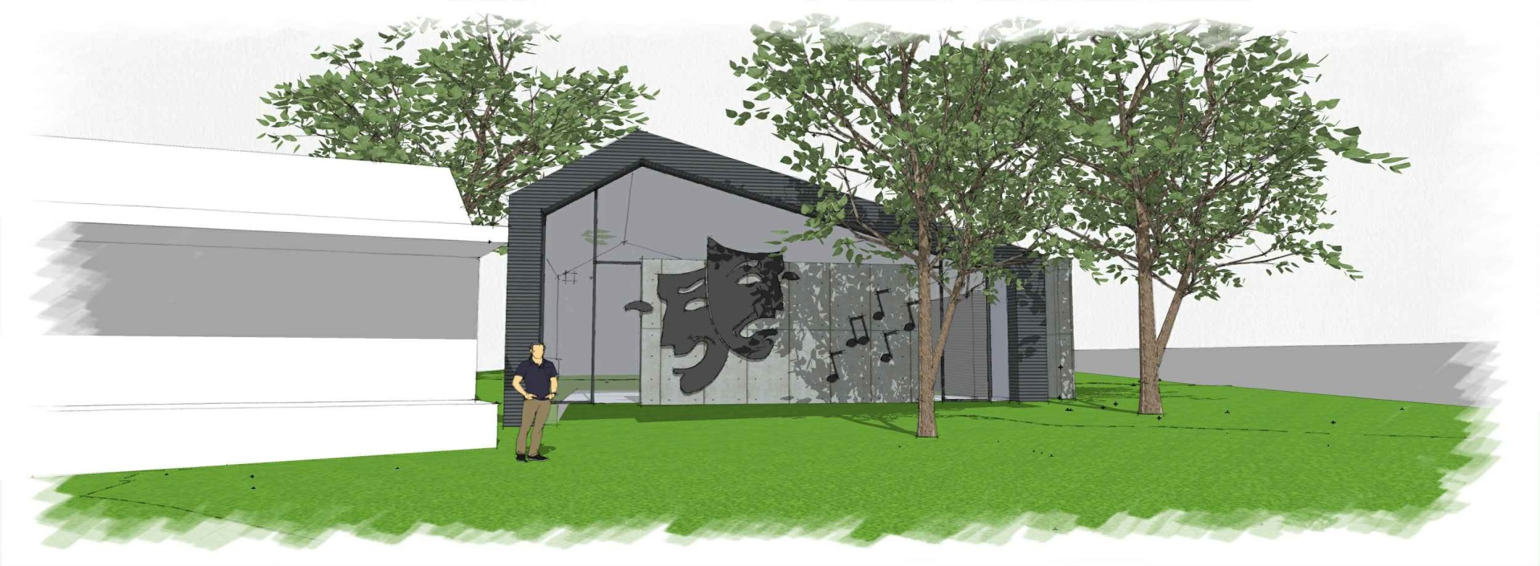
New Learning Space

Slide 4
HGHS remaining a fully selective school
According to the Hon. Alister Henskens (Member for Ku-Ring-Gai) no money has been budgeted or allocated in Treasury to add additional classrooms and teachers to the school.
HGHS will remain a fully selective school.
To quote a current parent, “Local students can come to Hornsby. They just need to get the right marks.”

Slide 5
HSC Minimum Standards 2019
All students in Year 10 from 2019 will need to complete a Literacy and Numeracy test online to demonstrate they have achieved a minimum standard of literacy and numeracy.
Students will have a number of opportunities during the year to achieve these standards.

Slide 6
Staffing 2018
Creative and Performing Arts - Mr Sohier, a targeted graduate teacher, is our new permanent Visual Arts teacher and Ms Neil is also a new Visual Arts teacher who is here on a part-time basis.
English - two new permanent members of staff Ms Carroll and Ms Thomas are both targeted graduate teachers.
HSIE – Mr Morris is our new Society and Culture and Junior Geography teacher.
Languages - Mrs Brown is our new German teacher.
PDHPE - Ms Roberts is our new PDHPE teacher.
Science - Mr Arthur is our new Physics teacher.
Our Relieving Head of English is Mrs Mallison (from Cherrybrook High School) while Dr Green is Relieving Deputy Principal (Years 8, 10 and 12) for Term 1.
Our Relieving Head Teacher of Mathematics is Mrs Tourikis while Mr Marshall is Relieving Deputy Principal (Years 7, 9 and 11).

Slide 7
New Parent Portal and App
Download school reports (Years 7 – 11), and from 2019 all reports.
View your daughter’s timetable and overall attendance.
Parent teacher booking interviews (from Semester two).
More details to come over the year.
Parents can currently pay online for excursions via school website

Slide 8
School Plan 2018 - 2020
Vision Statement - “Excellence in Girls’ Education” – we want Hornsby Girls High School to be the best school in Sydney.
Three focus areas for our plan:
Quality Teaching and Learning for Gifted Students
Student and Staff Wellbeing
Quality Systems and Learning Environments
We measure our success using the ‘School Excellence Framework’ developed by the D o E.

